Slide 1
Responses of animals to the biotic environment
Interspecific aggressive responses
Competition

Slide 2
Competition for food etc.
Gause’s Principle = the competitive exclusion principle.
No two species with the same niche can co-exist for long in the same place.
Either one or both species die out or they narrow or change their niche.

Slide 3
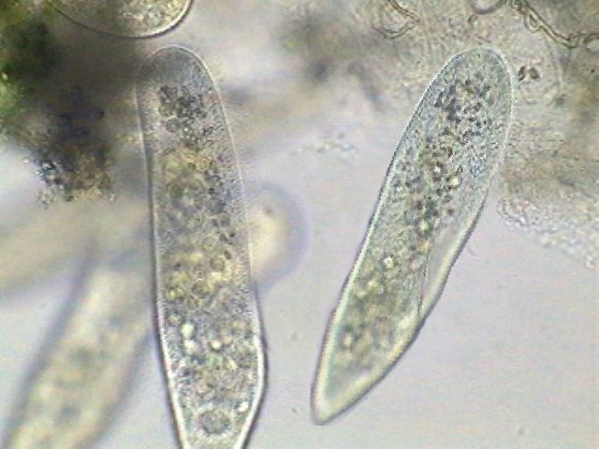
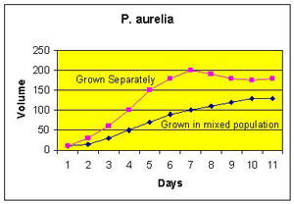
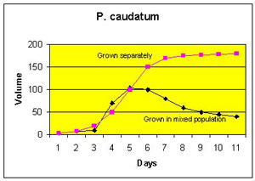
Gause studied 2 species of paramecium.
The graphs below showed that when grown together, one species died out.

Slide 4

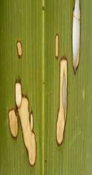
New Zealand example of narrowing of the Niche.
The caterpillars of 2 species of moths both feed on flax leaves.
They reduce competition by eating different parts of the leaves.
  The “notching” caterpillar seldom eats all the way to the mid-vein.
  The “window” caterpillar seldom eats near the edge.

